Slide 1
REDUCING CARBON FOOTPRINT IN IOT DEVICES
Team name: ProTechIOT
College: SSN College of Engineering
Industry: Ericsson

Slide 2
IMPLEMENTATION METHODOLOGY
Timing channel: encoding data in silence zone.
A specific recurring sequence (X) is given a silence period of time t
and is decoded by the receiver. Whenever it receives a silence period of
t, it assumes the value to be X. Thus the original value is obtained
without it getting transmitted and thus saving energy.
Data to be transmitted: 11 10110 0010 10110 101
Data to be encoded in silence of 5 seconds: 10110
Normal Algorithm:
Transmitter
1110110001010110101
Receiver
Using timing channel:
11<silence of 5 sec> 0010 <> 101
Receiver
Transmitter
No of bits saved: 10
Efficiency: 53%
Energy saved:
The above was implemented using TCP/UDP protocols and using Xbee Communication devices.

Slide 3
SMART ALGORITHM – REDUCTION OF REDUNDANT DATA
An algorithm which does not transmit sensor data values if there is any inconsiderate change in the sensor value (as defined by the user), there by reducing the number of transmissions is used.
Data to be transmitted: [ 26, 28, 28, 27, 26, 26, 26]
Transmitter
Transmitted
Receiver
26
Transmitted
26
28
28
28
28
27
Transmitted
28
26
26
26
26
26,
26
No of bits saved: 448
Efficiency: 57%
Energy saved:
Data Transmitted: [26,28,26]
Data Received: [26,28,26]
Data Interpreted: [26.28,28,28,26,26,26]

Slide 4
COMBINING SILENCE PERIOD WITH ELIMINATION OF REDUNDANT DATA
Step 1: Smart algorithm check – to remove redundant data.
Data to be transmitted: [ 26, 28, 28, 27, 26, 26, 26]
Data Transmitted: [26,28,26]
Step 2: For the output of the smart algorithm, timing channel sequence of 10110 is encoded and sent.
Step 3: The timing channel encoded sequence is received and decoded. Data decoded is[26 28 26]. data interpreted using Smart algorithm. [ 26, 28, 28, 27, 26, 26, 26]
No of bits saved: 448
Efficiency: 57%
Energy saved:

Slide 5


COMPRESSION SENSING ALGORITHM
Algorithm to reduce the size of images and videos transmitted to reduce data rate.
Implementation: Compressive sensing is a signal processing technique for efficiently acquiring and reconstructing a signal, by finding solutions to under determined linear systems. It is based on the principal that many signals are sparse, i.e, they contain many coefficients close to or equal to zero, when represented in some domain. This is the same insight used in many forms of lossy compression.
Input image:
PSNR: 33.6017 dB
Compressed image:

Slide 6
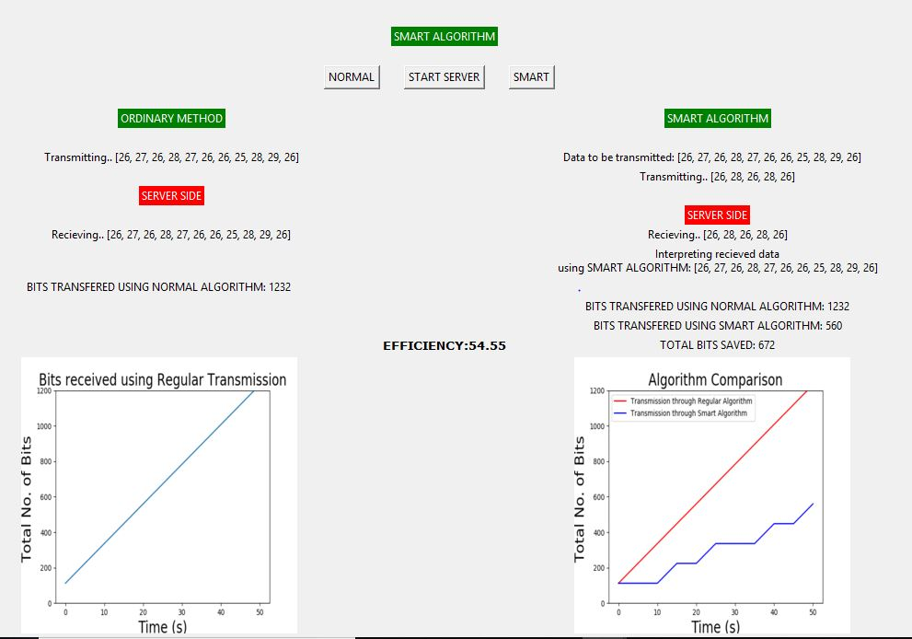
RESULTS
Carbon footprint emissions:
0.83kg CO2/KWh
Sample GUI

